Slide 1
CS489: Applied Software Development

Slide 2
Lesson 1b:
SOFTWARE BUILD AUTOMATION
(Apache Maven, Gradle) and
CI/CD PIPELINES
Notes:
https://resources.github.com/ci-cd/ (Building Automated workflows for faster releases) - CI/CD automates your builds, testing, and deployment so you can ship code changes faster and more reliably

Slide 3
Wholeness
Automation is the use of technology to perform tasks with reduced or no human assistance/intervention.
Software Build constitutes the process of compiling source code, executing tests and creating a deployable unit or package/artifact.
Science of Consciousness: Thought leads to Action. Action leads to Achievement. Achievement leads to Fulfillment.
Notes:
Software artifact – packaged software ready for release/consumption

Slide 4
Software Build Automation
Automation of the Software build process is an essential requirement for a quick and efficient release of software product and subsequent updates.
For modern business software products the Build -> Test -> Release cycle needs to be fast, frequent and error-free.

Slide 5
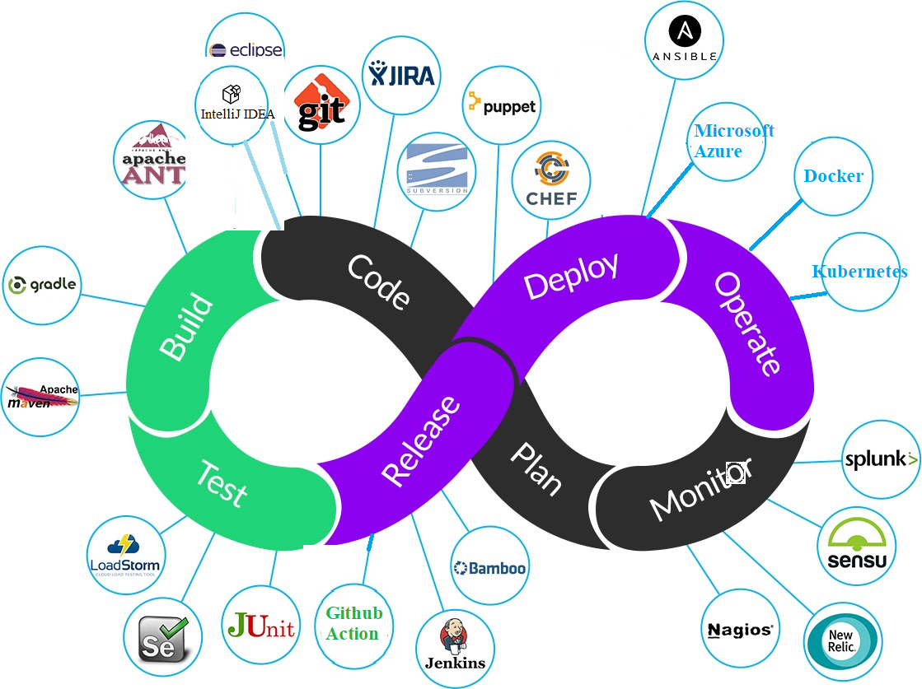
DevOps Life-cycle: Plan -> Code -> Build -> Test -> Release

Slide 6
Build Automation Tools
Commonly used Software build automation tools:
Apache Maven
Gradle
Github Action
Jenkins

Slide 7
Apache Maven
Apache Maven is an open-source software build automation and dependency management tool, preeminent within the Java application development space.
Maven uses the concept of a Project Object Model (POM) to manage the software build operation
Every Maven project uses a pom.xml file which contains build configuration data

Slide 8
Demo: Apache Maven
Maven requires the JDK installed
Obtain and setup Apache Maven from the download webpage at: Maven – Download Apache Maven
(Optional) Add ‘bin’ folder to PATH env var
(Optional) Add environment variables named:
MAVEN_HOME
M2_HOME
Test: Open a cmd/terminal and run – mvn -v

Slide 9
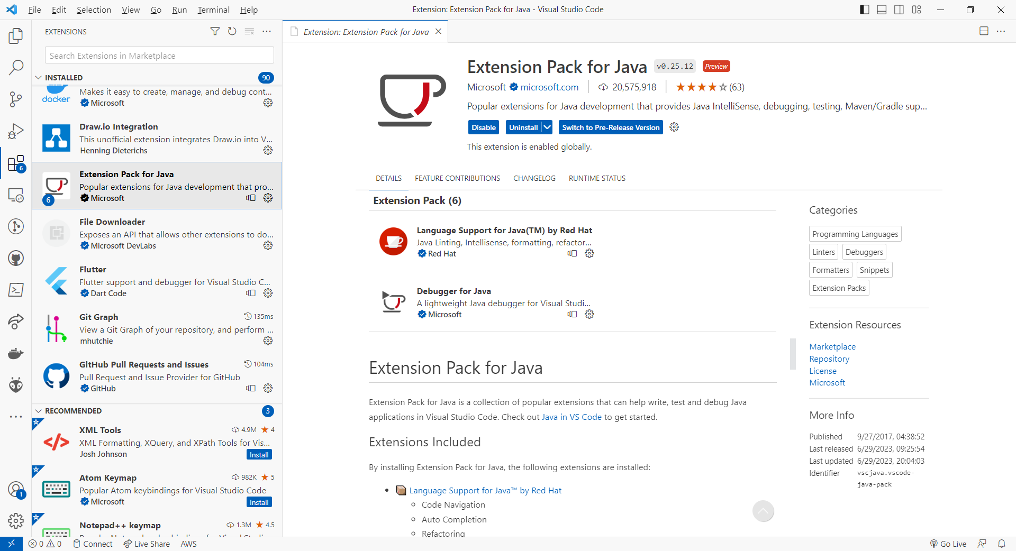
Demo: Apache Maven
Create a sample Project and execute a Maven build
Using VS Code with Extension Pack for Java

Slide 10
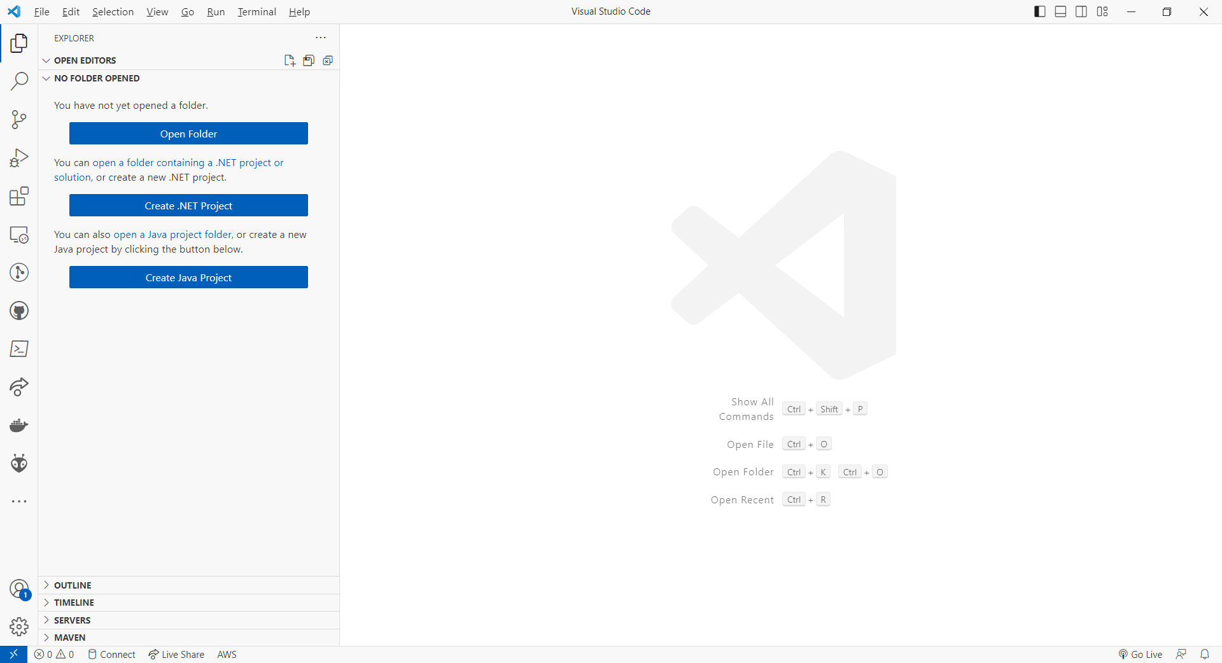
Demo: Apache Maven
Select the “Create Java Project” button

Slide 11
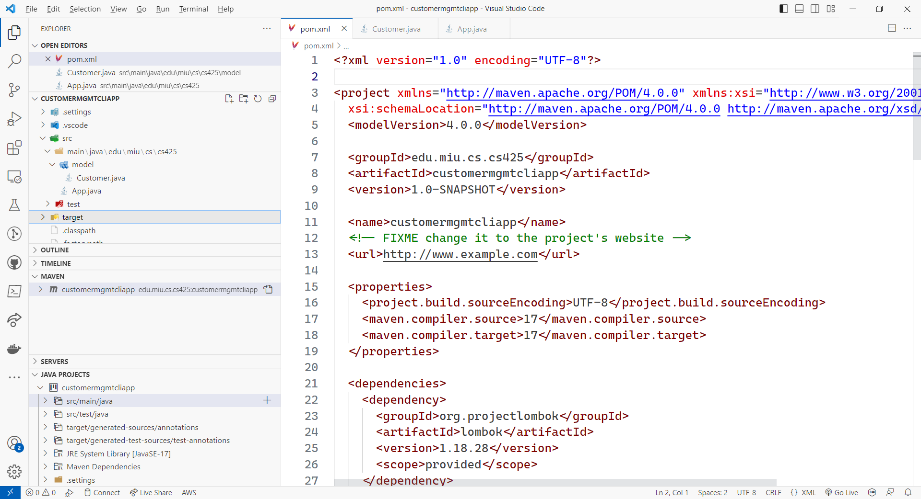
Demo: Apache Maven
Project code implemented - CustomerMgmtCLIApp

Slide 12
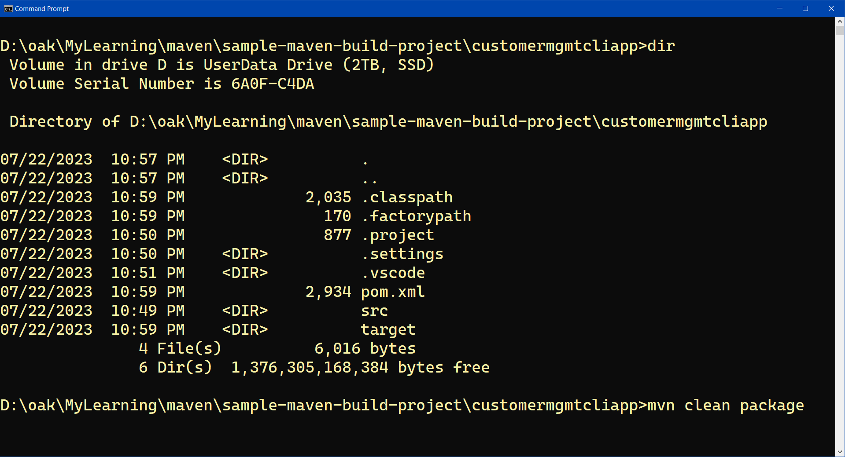
Demo: Apache Maven
Execute Maven clean package

Slide 13
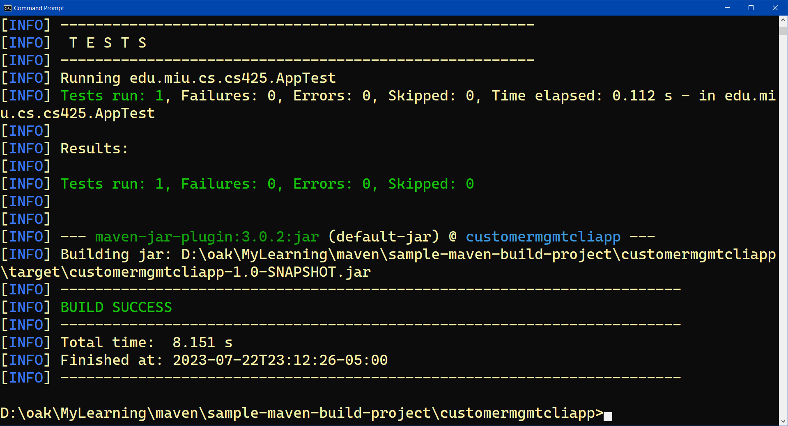
Demo: Apache Maven
Build success

Slide 14
Key features of Apache Maven
Project generator CLI tool e.g. mvn archetype:generate -DgroupId=ToolsQA -DartifactId=DemoMavenProject -DarchetypeArtifactId=maven-archetype-quickstart -DinteractiveMode=false
Maven Archetypes – like predefined project templates for creating various types of apps
Maven Repositories e.g Maven Central repo at https://mvnrepository.com/repos/central
Maven Phases and Goals: mvn compile, mvn clean, mvn package, mvn test etc.
Maven Plugins: e.g. maven-compiler-plugin etc

Slide 15
Gradle
Gradle is an open-source build automation tool, offering greater flexibility and higher performance than Maven, and popular within the Java application development space.
Every Gradle project contains a build script, which is a file located in the project’s root directory usually named, build.gradle
Build scripts define tasks, dependencies, plugins and other project configuration data.

Slide 16
Demo: Gradle
Gradle requires the JDK installed (version 8+)
Installing a local Gradle:
MacOS: You use - brew install gradle
For Windows: download zip bundle containing the binary from https://gradle.org/releases/, unzip, set GRADLE_HOME and add GRADLE_HOME\bin to PATH
(Optional) Add ‘bin’ folder to PATH env var
(Optional) Add environment variables named:
GRADLE_HOME
Test: Open a cmd/terminal and run – gradle -v
Notes:
https://gradle.org/install/

Slide 17
Demo: Gradle
Create a sample Project and execute a Gradle build
Using VS Code with Extension Pack for Java

Slide 18
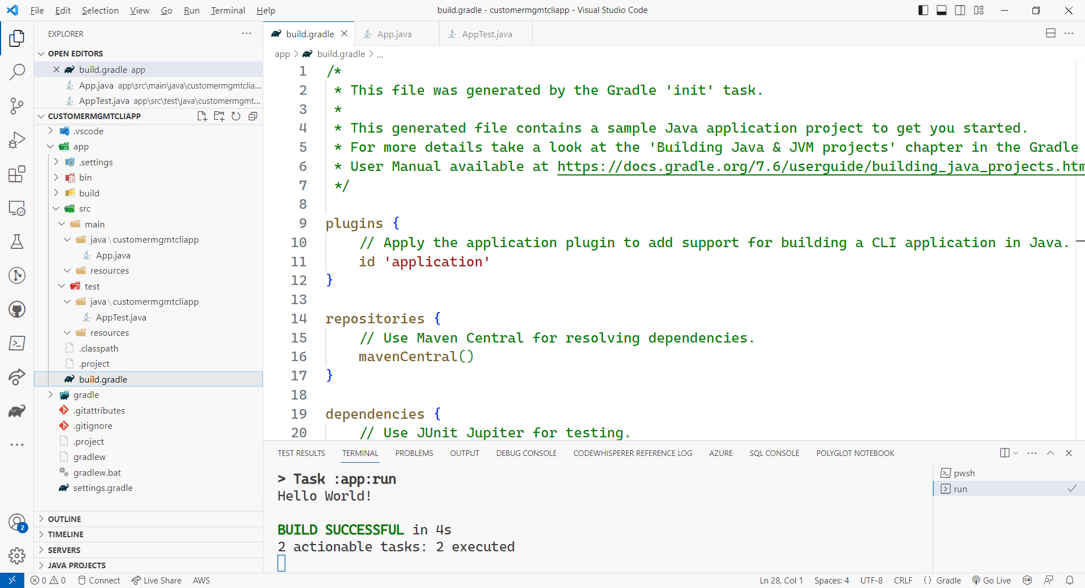
Demo: Gradle
Project code implemented - CustomerMgmtCLIApp
Notes:
Note: Install VSCode Extension - Gradle for Java

Slide 19
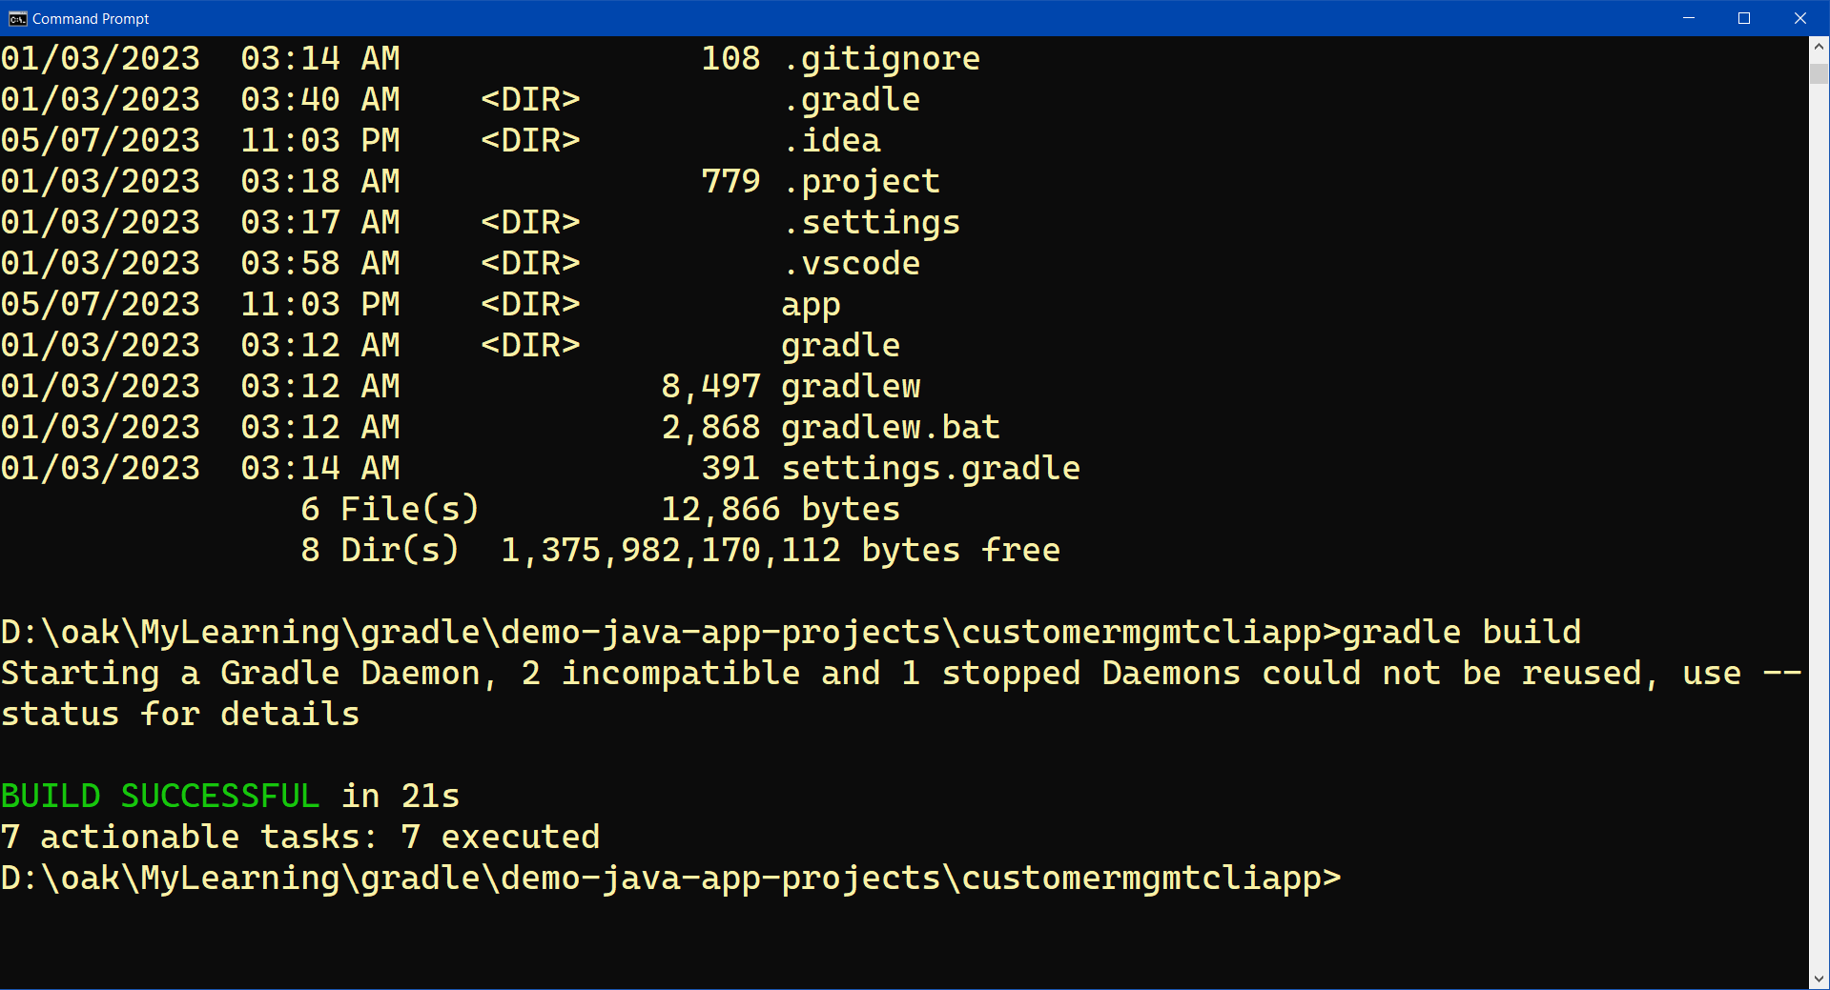
Demo: Apache Maven
Execute gradle build
Notes:
Execute the software: java –jar .\app\build\libs\app.jar ; Next, make code change in getGreeting method to return null. Rerun gradle build and see that the build fails due to app:test task failing

Slide 20
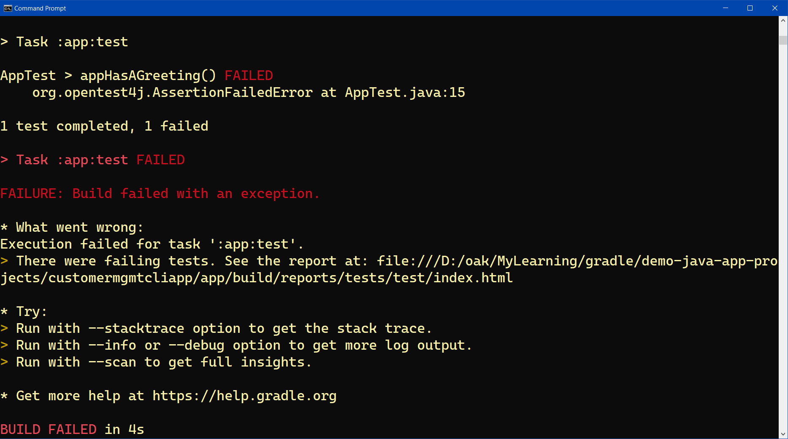
Demo: Apache Maven
Change the Test code to cause/simulate failing test
Execute gradle build and see that it fails
Notes:
Execute the software: java –jar .\app\build\libs\app.jar ; Next, make code change in getGreeting method to return null. Rerun gradle build and see that the build fails due to app:test task failing

Slide 21
CI/CD
CI/CD – Continuous Integration (CI), Continuous Delivery (CD). Note: The ‘D’ in CD can sometimes mean ‘Deployment’, which includes additional steps in the workflow beyond ‘Delivery’ (as will be explained later).
CI/CD is aimed at automating the build, testing and deployment of software so that new features can ship faster and more reliably.
Automation is a core principle for achieving DevOps success and CI/CD is a critical part.
Notes:
Manually integrating code changes is a total non-starter in modern software development. Problem example: Past class project students trying to copy/merge code files. #Madness!

Slide 22
CI/CD
A CI/CD Pipeline is a series of automated workflows setup as part of the DevOps methodology and best practice to enable the elimination or reduction of manual tasks.
Continuous Integration (CI) automatically builds, tests and integrates (packages) code through use of a shared repository;
Notes:
Manually integrating code changes is a total non-starter in modern software development. Problem example: MPP class project students trying to copy/merge code files. #Madness!

Slide 23
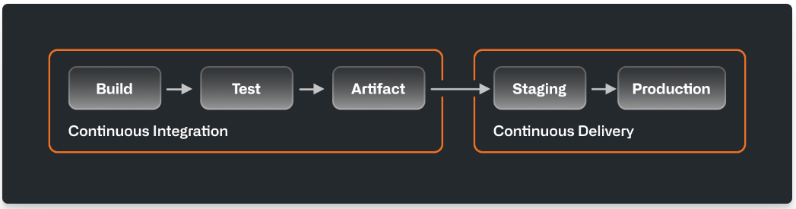
CI/CD
Continuous Delivery (CD) automatically delivers the packaged software artifact to a production-ready (staging) environment for approval.
Notes:
Manually integrating code changes is a total non-starter in modern software development. Problem example: MPP class project students trying to copy/merge code files. #Madness!

Slide 24
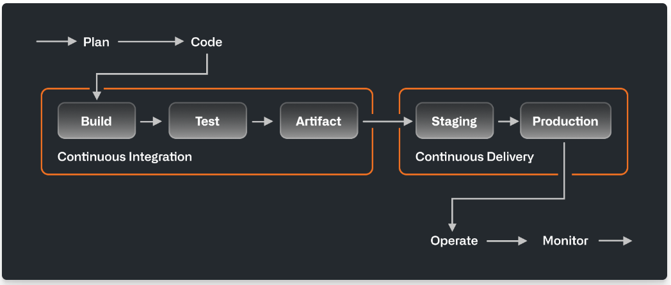
CI/CD
Continuous Deployment (CD) automatically deploys the software to end-users or customers directly.
Notes:
When someone says CI/CD, the “CD” they’re referring to is usually continuous delivery, not continuous deployment. What’s the difference? In a CI/CD pipeline that uses continuous delivery, automation pauses when developers push to production. A human—your operations, security, or compliance team—still needs to manually sign off before final release, adding more delays. On the other hand, continuous deployment automates the entire release process. Code changes are deployed to customers as soon as they pass all the required tests.
Continuous deployment is the ultimate example of DevOps automation. That doesn’t mean it’s the only way to do CI/CD, or the “right” way. Since continuous deployment relies on rigorous testing tools and a mature testing culture, most software teams start with continuous delivery and integrate more automated testing over time

Slide 25
CI/CD
Most modern software teams make CI/CD an integral part of their development workflow by using a combination of automated process, steps and tools:
Version Control system (VCS): CI begins via use of shared repositories, where the team can collaborate on code using tools like Git and Github.
Build automation tools: Teams use CI build tools to automatically compile, package code and config files into release candidate consisting of executable, deployable artifacts to be tested for quality, performance and other requirements.
Notes:
After clearing required checks, CD tools send builds off to the operations team for further testing and staging.
Continuous integration stack
General automation, build tools, package managers, testing and code coverage tools
Learn more about CI testing
Reviews and approvals
Treating code review as a best practice improves code quality, encourages collaboration, and helps even the most experienced developers make better commits. In a CI/CD workflow, teams review and approve code in pull requests or leverage integrated development environments for pair programming.
Code review stack
Collaborative coding, code review tools, automated reminders, pull requests
Learn more about code review
Environments
CI/CD tests and deploys code in environments, from where developers build code to where operations teams make applications publicly available. Environments often have their own specific variables and protection rules to meet security and compliance requirements.

Slide 26
Demo of CI/CD
To demonstrate the setting-up of a CI/CD pipeline, we will be using Github Actions
(Note: Alternatives – Jenkins, CircleCI, Bamboo, GitLab, Teamcity, Travis etc.)
Unlike the above mentioned alternative CI/CD tools, Github Action is native to and fully integrated within the Github webapp. Hence a team that uses Github as the code repository will naturally prefer/choose Github Action for CI/CD pipeline.
Notes:
Manually integrating code changes is a total non-starter in modern software development. Problem example: Past class project students trying to copy/merge code files. #Madness!

Slide 27
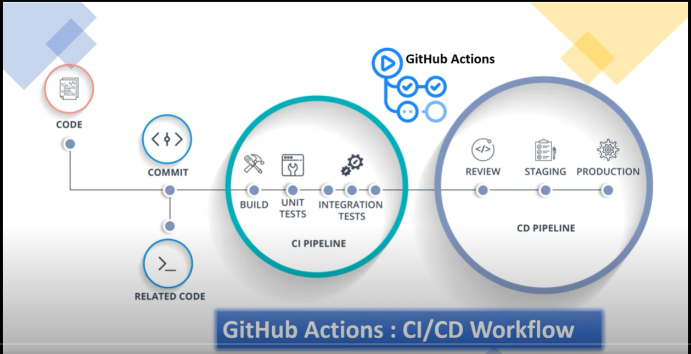
Demo of CI/CD
Typical steps of activities/tasks with CI and CD
Notes:
Manually integrating code changes is a total non-starter in modern software development. Problem example: Past class project students trying to copy/merge code files. #Madness!

Slide 28
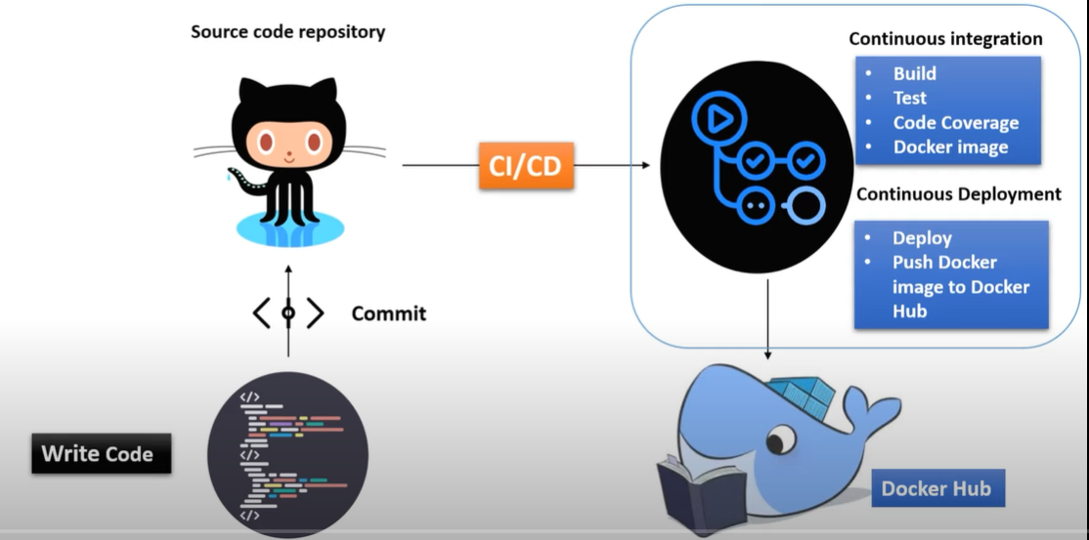
Demo of CI/CD
Workflow and tools with CI and CD
For this lesson1b, CI will only Build, Test and Package
In future demo, Docker hub will be added as deployment target
Notes:
Manually integrating code changes is a total non-starter in modern software development. Problem example: MPP class project students trying to copy/merge code files. #Madness!

Slide 29
Demo: Github Action
Create a new Maven Java CLI project
Project code implemented - CustomerMgmtCLIApp

Slide 30
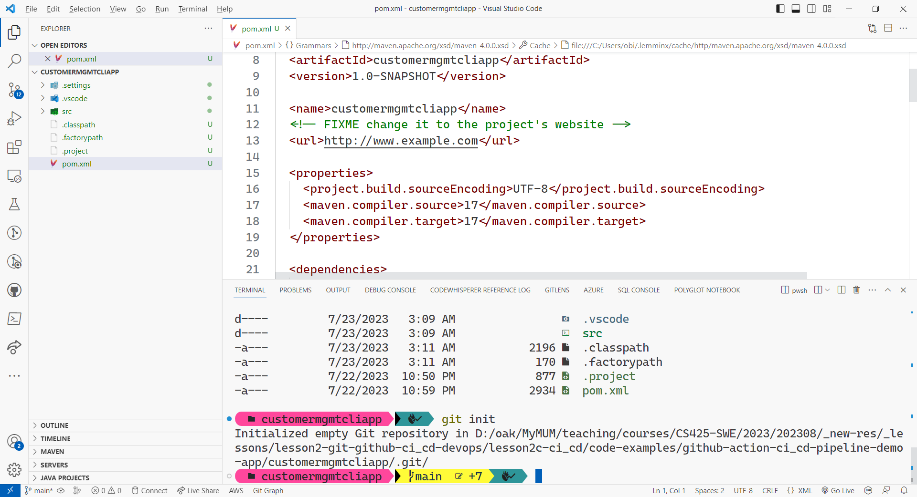
Demo: Github Action
Initialize a new git local repository – open terminal and execute: git init

Slide 31
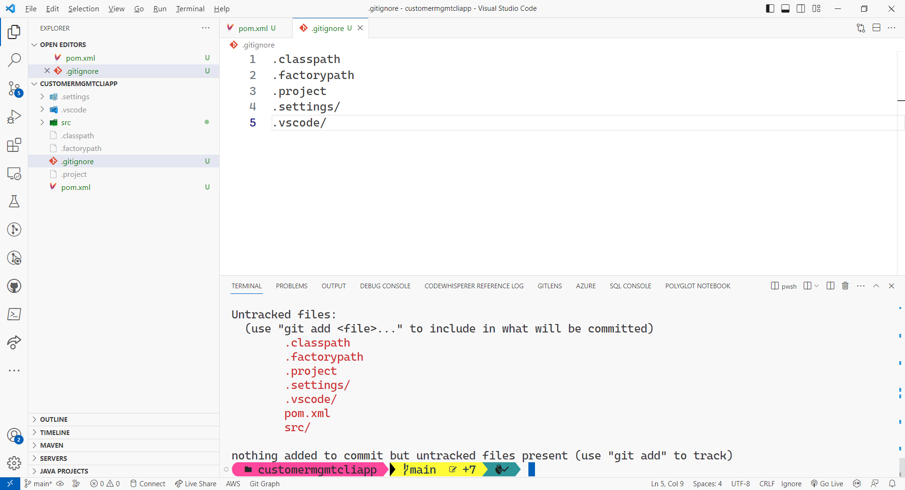
Demo: Github Action
Add .gitignore file

Slide 32
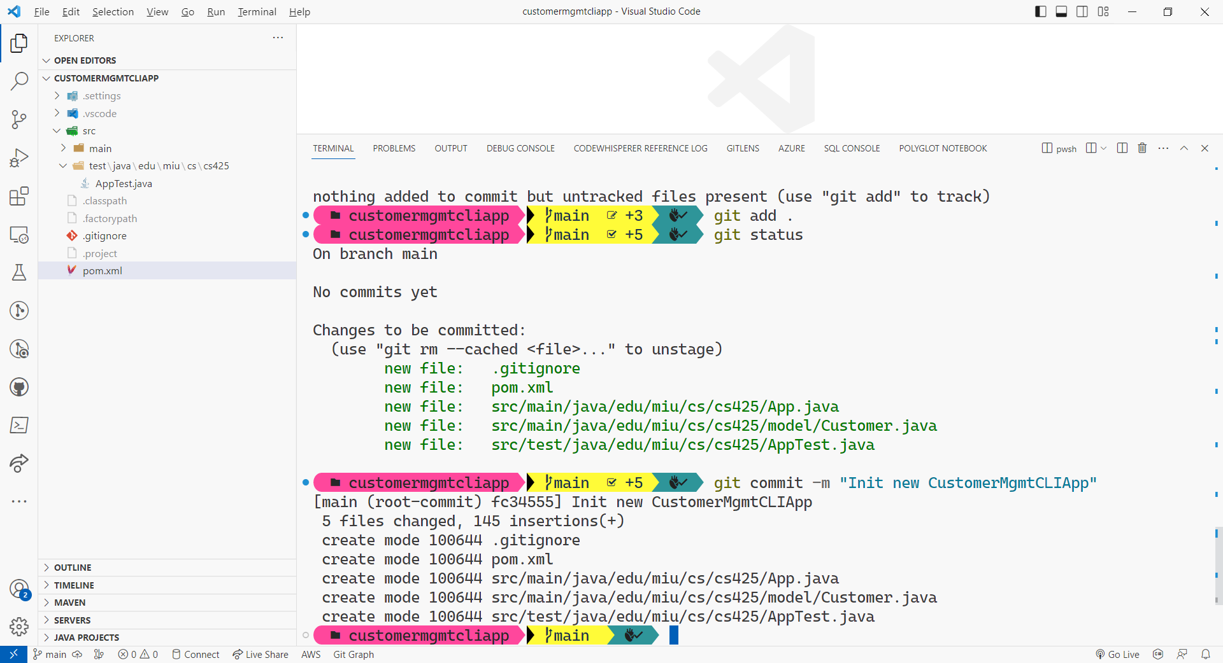
Demo: Github Action
Execute: git add .
Execute git commit –m “Init new CLI app”

Slide 33
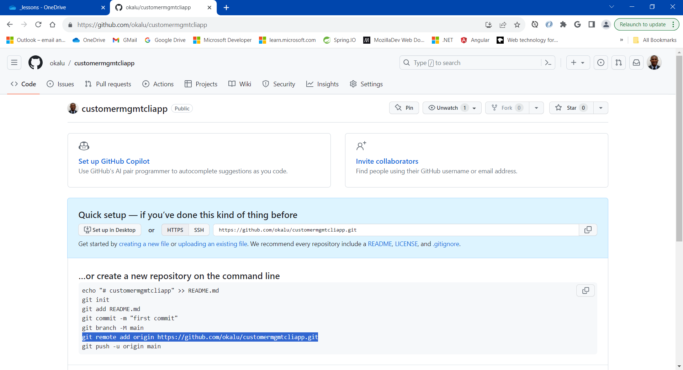
Demo: Github Action
Create the remote repository on github

Slide 34
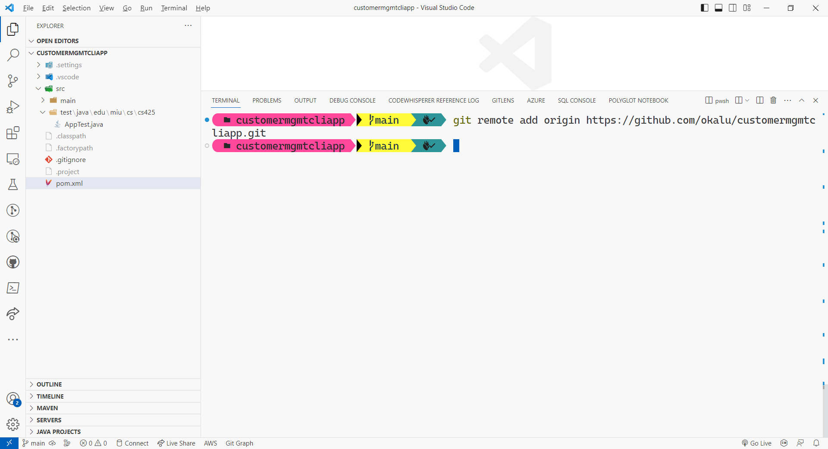
Demo: Github Action
Add reference named origin pointing to the remote repository by executing:
git remote add origin <url>

Slide 35
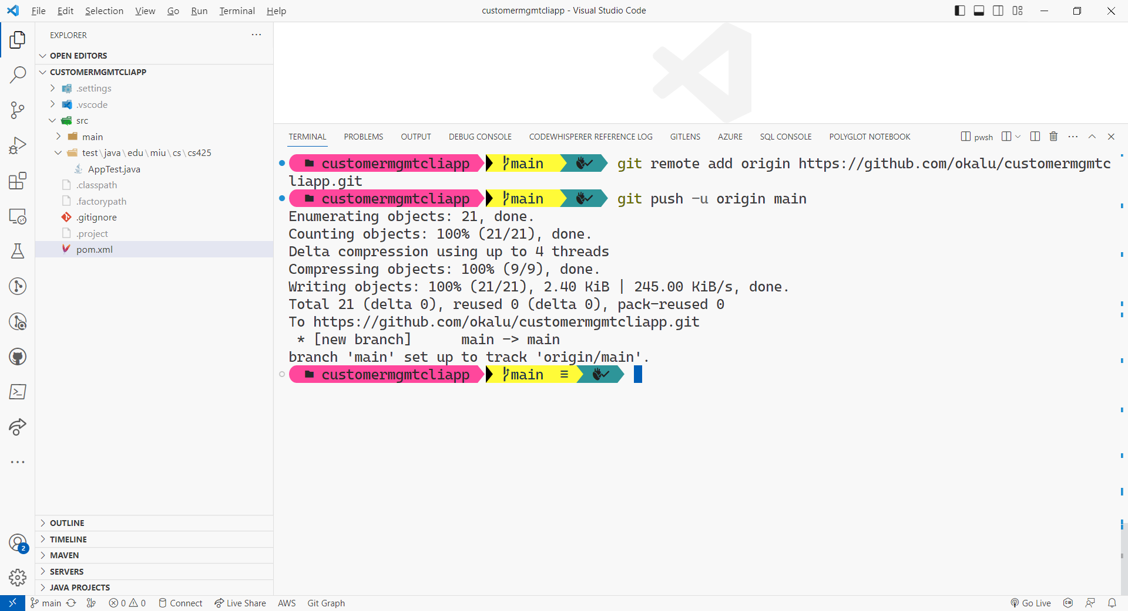
Demo: Github Action
Push the code to the remote repository by executing:
git push –u origin main

Slide 36
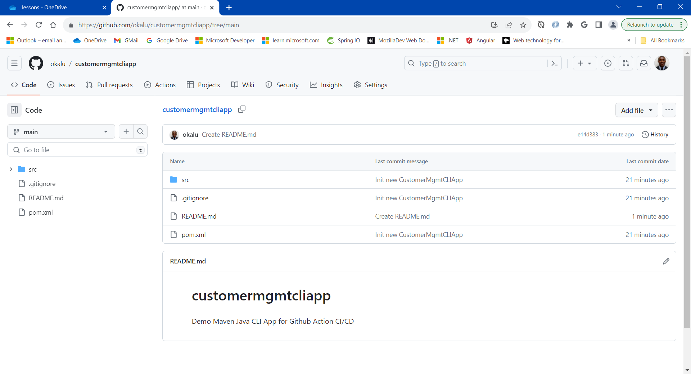
Demo: Github Action
Code successfully pushed to the remote repository on github. And a README.md file was added/committed directly by me

Slide 37
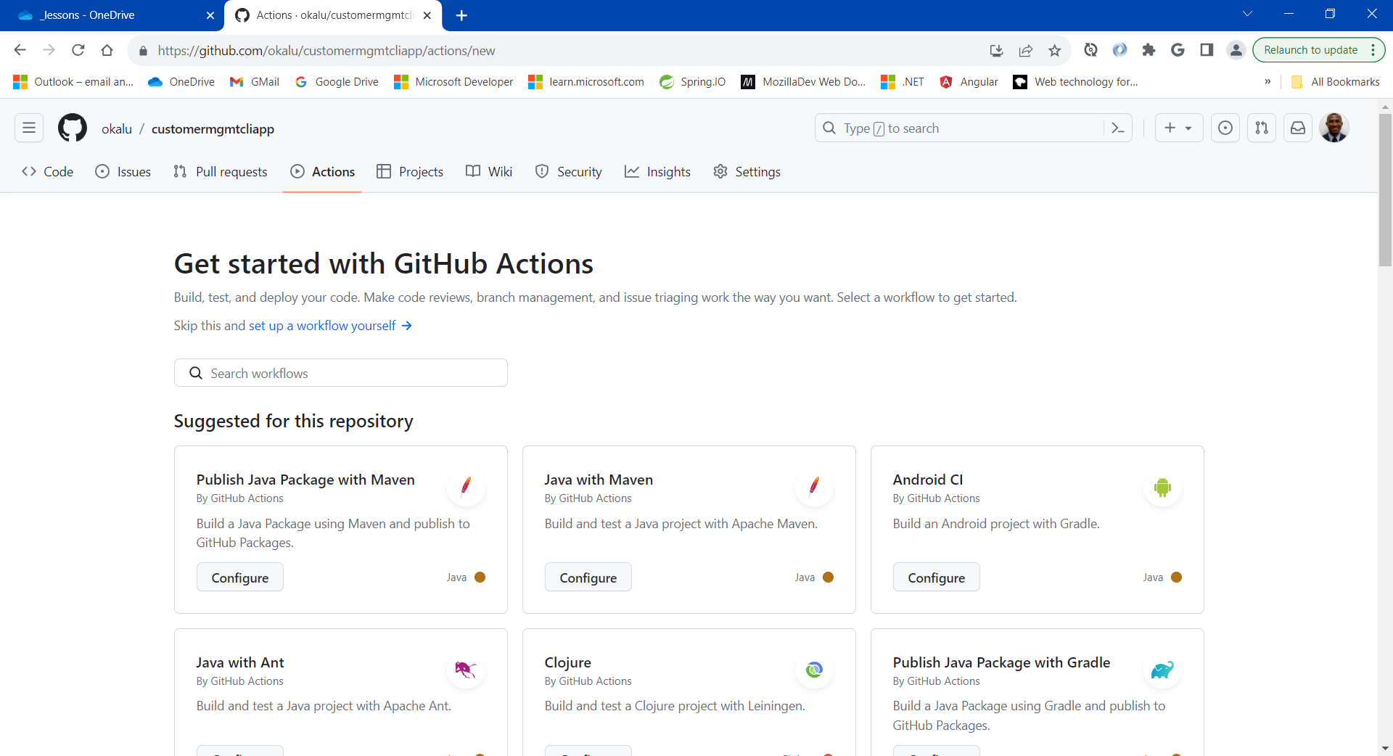
Demo: Github Action
Select/open the repository’s ‘Actions’ tab on github

Slide 38
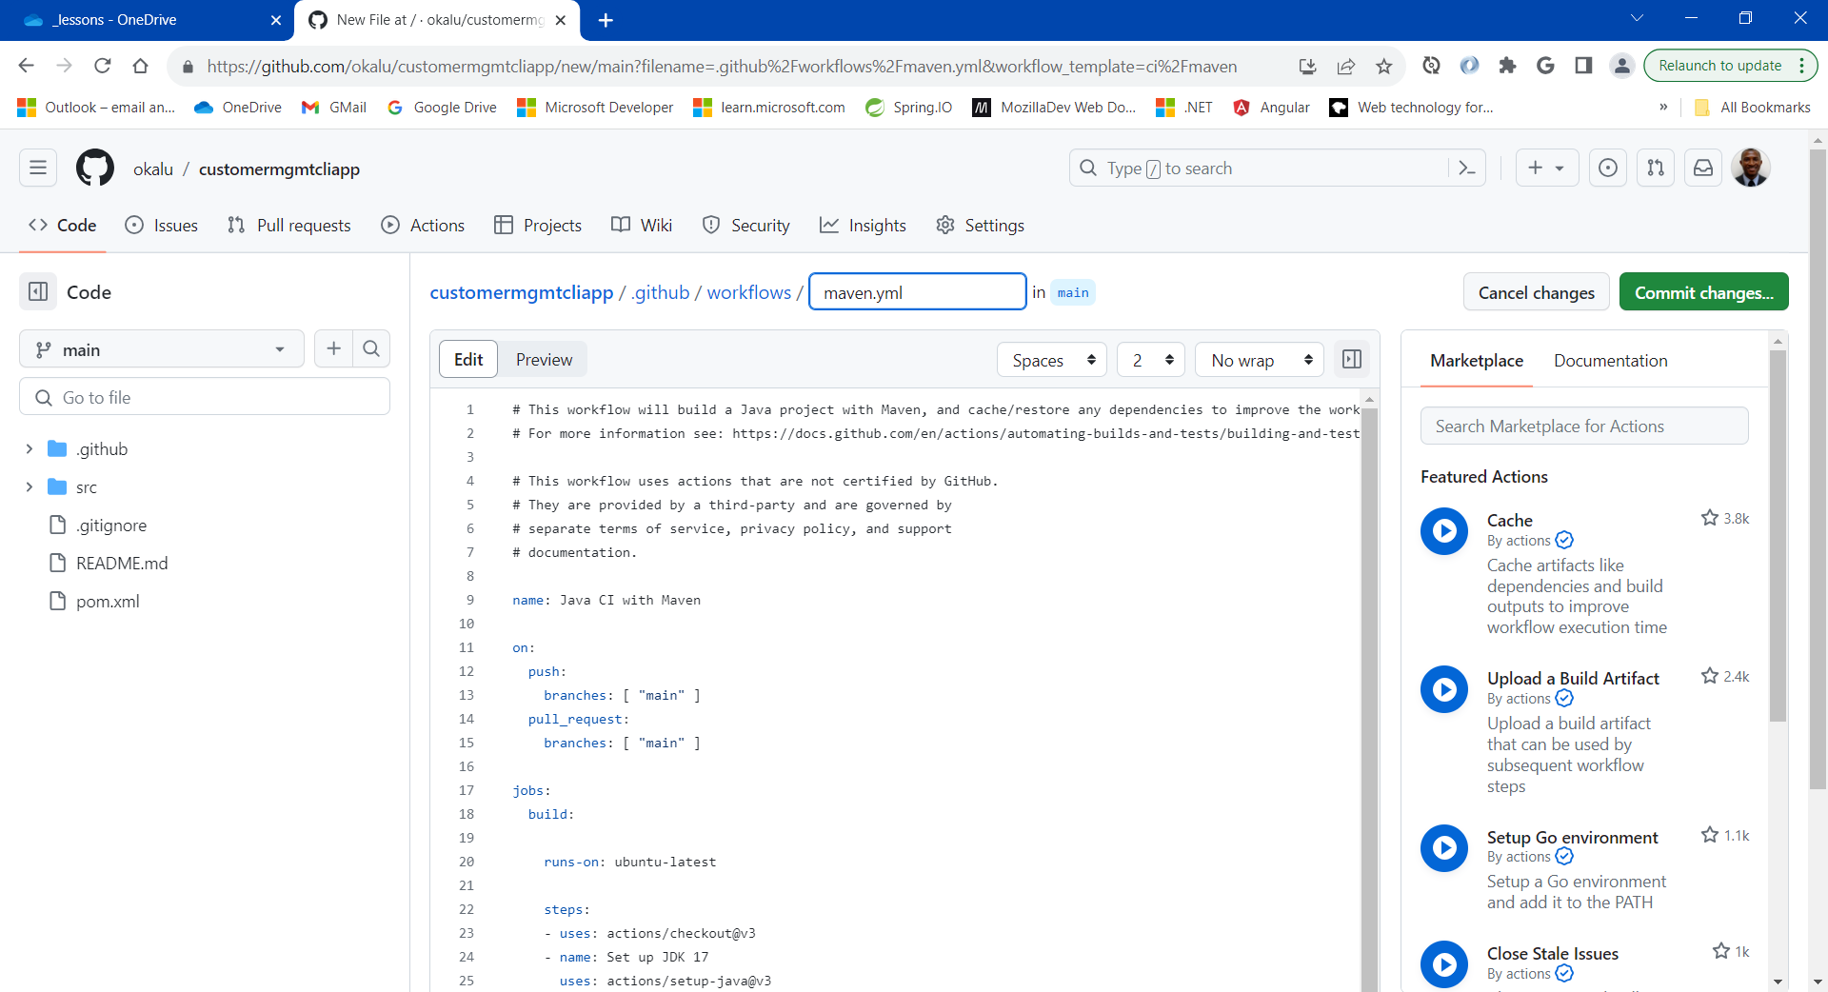
Demo: Github Action
Select the preconfigured workflow template named: “Java with Maven”, which builds and test a Java project with Apache Maven. Then, click “Configure”

Slide 39
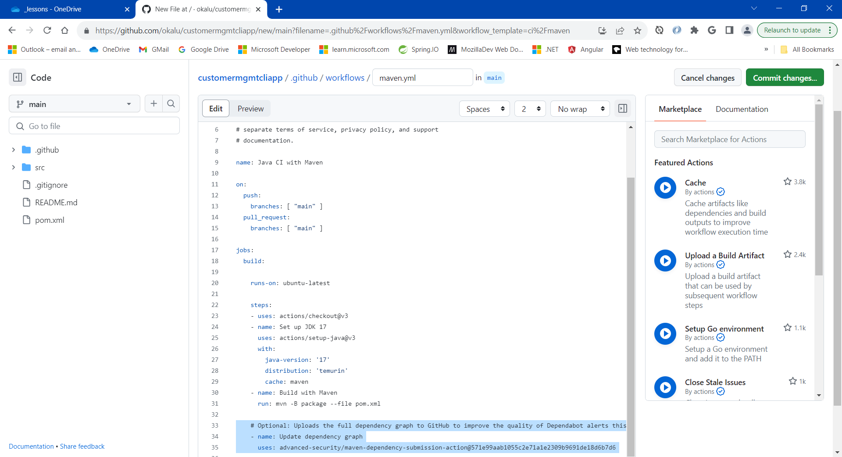
Demo: Github Action
Edit the workflow’s configuration, as shown below
Delete Lines 33, 34 and 35
Click on the “Commit changes…” button
Next, execute git pull origin main to download the new github actions workflow config yaml file

Slide 40
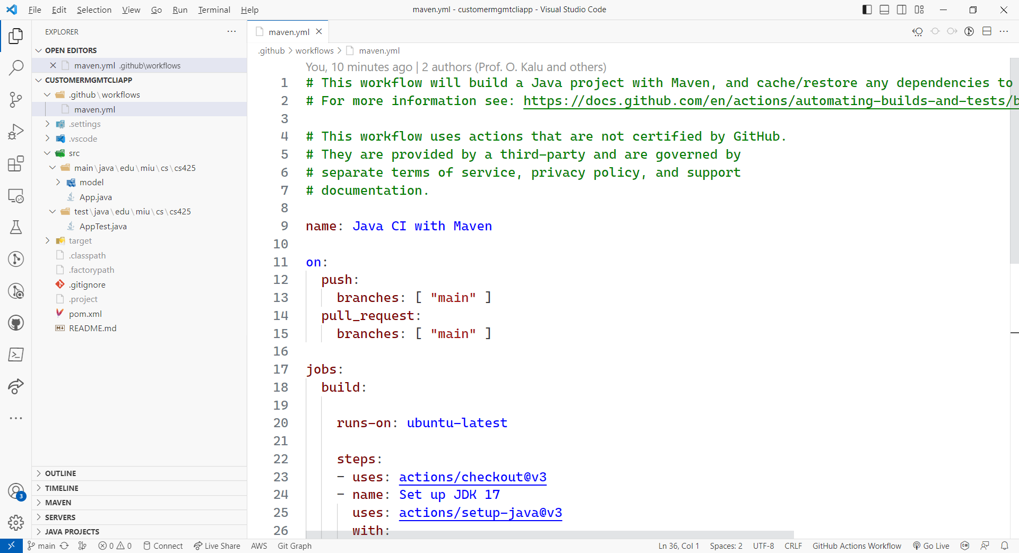
Demo: Github Action
Next, execute ‘git pull origin main’ to download the new github actions workflow config yaml file
Notes:
https://docs.github.com/en/repositories/releasing-projects-on-github/about-releases, https://docs.github.com/en/packages/learn-github-packages/introduction-to-github-packages

Slide 41
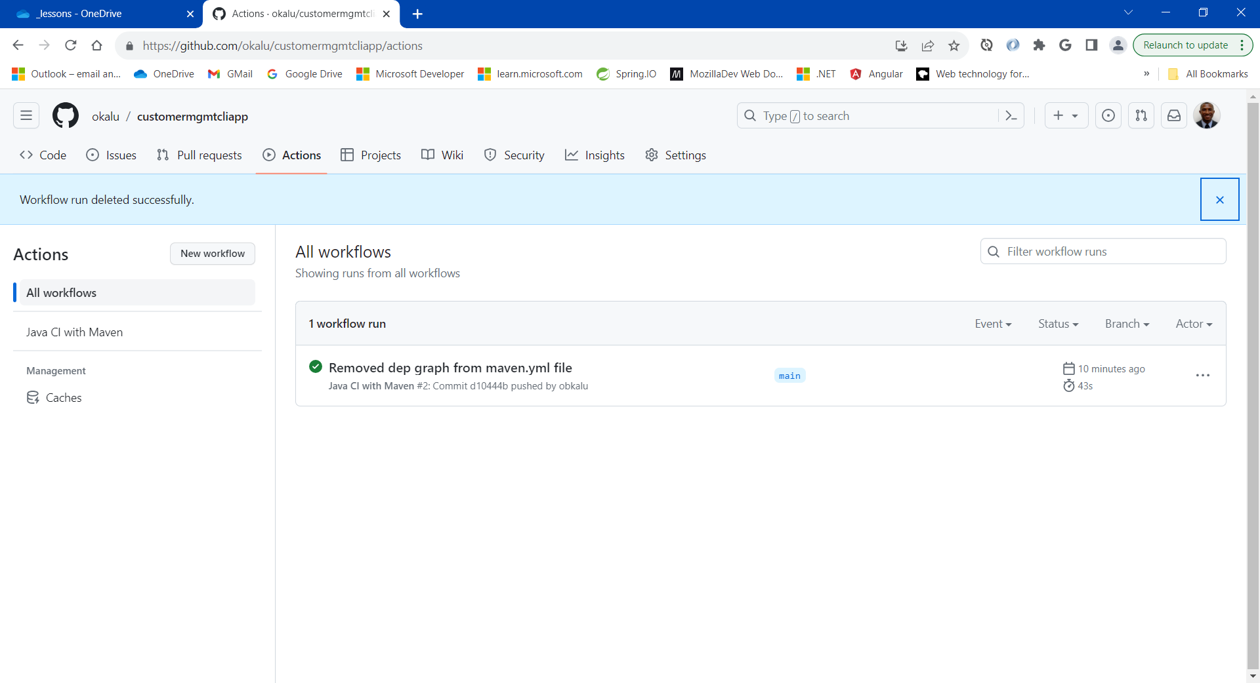
Demo: Github Action
Check the Github Actions tab and see that the workflow executes successfully, having been triggered by the commit/push made.
Notes:
https://docs.github.com/en/repositories/releasing-projects-on-github/about-releases, https://docs.github.com/en/packages/learn-github-packages/introduction-to-github-packages

Slide 42
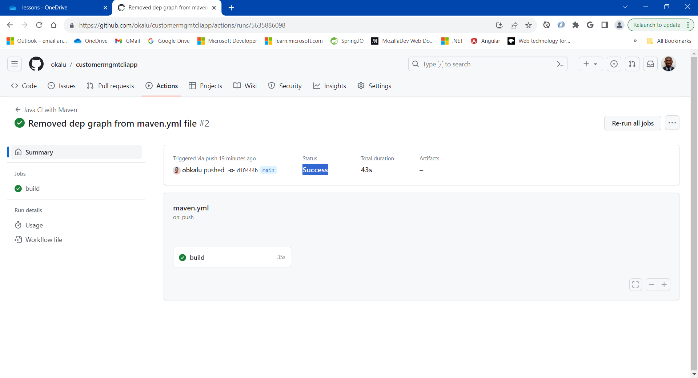
Demo: Github Action
Check the Github Actions tab and see that the workflow executes successfully, having been triggered by the commit/push made.
Notes:
https://docs.github.com/en/repositories/releasing-projects-on-github/about-releases, https://docs.github.com/en/packages/learn-github-packages/introduction-to-github-packages

Slide 43
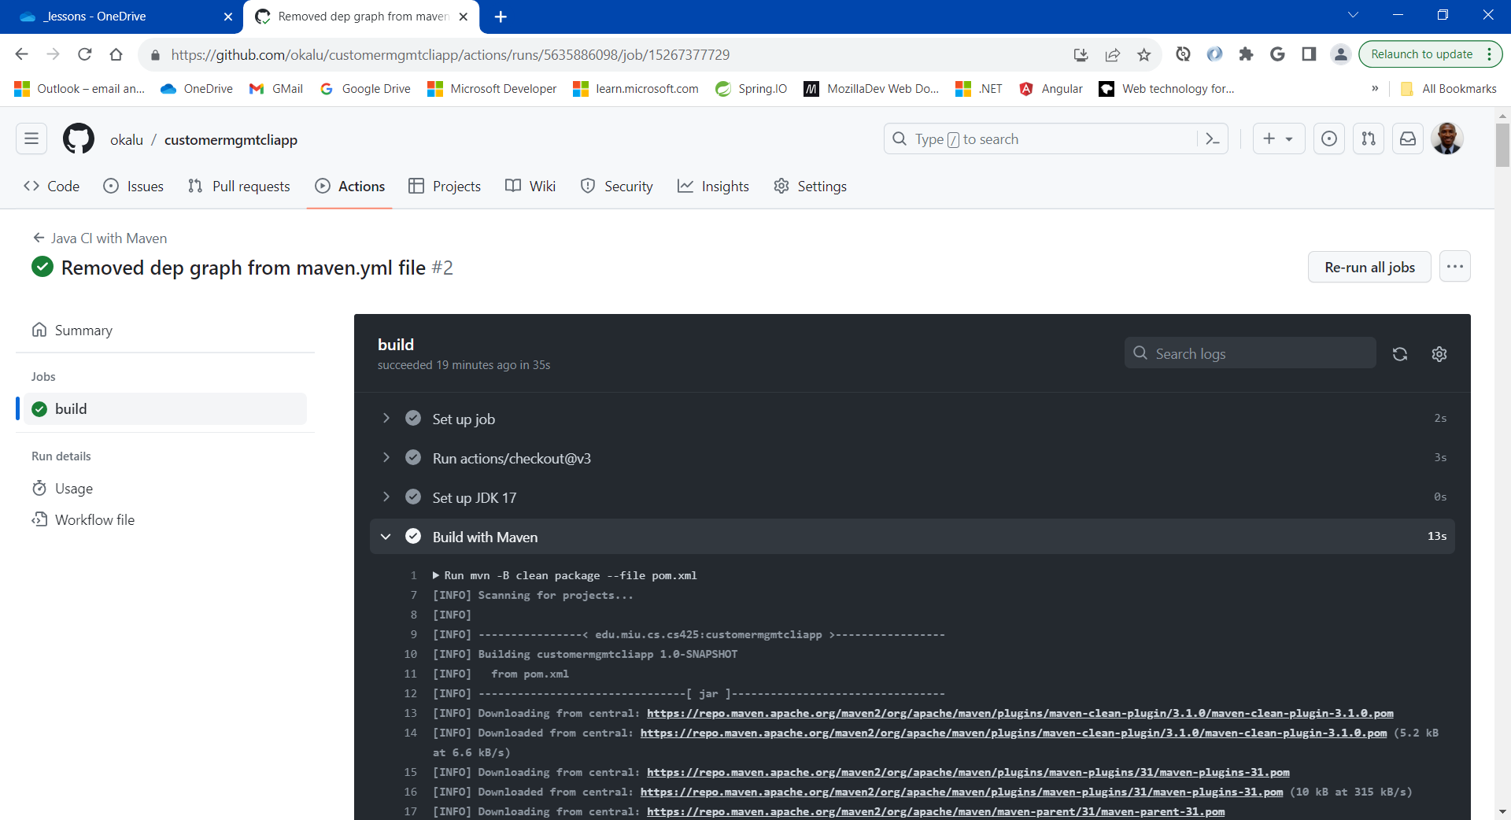
Demo: Github Action
Check the Github Actions tab and see that the workflow executes successfully, having been triggered by the commit/push made.
View the execution log
Notes:
https://docs.github.com/en/repositories/releasing-projects-on-github/about-releases, https://docs.github.com/en/packages/learn-github-packages/introduction-to-github-packages

Slide 44
CS489: Applied Software Development

